Slide 1
PoE Passthrough Proposal
Brandon Beader & Diang Xing
8/30/2023

Slide 2
Contents
TI PoE Portfolio
  PD Section
  PSE Section
Passthrough (daisy chaining)
  Benefits of passthrough
  Block diagram
  TI solutions for PoE daisy chaining
Device Information
  TPS23881B1
  TPS2372-3

Slide 3
TI PoE Portfolio

Slide 4
PoE PD Selection Flowchart
Power level
<13W (Class 1-3)
≤ 71.3W (Class 5-8)
N / Buck
Isolated
Design?
≤ 25.5 W
(Class 4)
Power Level<=51W
Y / Flyback
(Recommended)
YES
Isolated or Non-Isolated?
Primary or Secondary side Regulation?
Non-Isolated
Secondary(w/ Opto)
NO
Isolated
Isolated Design?
Y / Flyback
Primary
Which Topology?
Flyback
Isolated Design?
N / Buck
N / Buck
Vout level?
>=12V
ACF
Y / Flyback
or ACF
3.3V/5V
TPS23755
(Smooth Transition w. AUX)
TPS23758
TPS23753A
NEW
TPS23731
NEW
TPS23734
TPS2378
NEW
TPS23730
TPS2372
(Also for dual input)
TPS2373 - 4
(Generally more recommended than TPS2372)

Slide 5
PSE selection flowchart
RTM’d
In development
Power level > 30 W ?
YES
NO
TPS23881
8 channel
FirmPSE compatible
Need more than 4 channels?
NO
YES
OR
TPS23881B1
8 channel
FirmPSE compatible
Autonomous mode
TPS23882
8 channel
FirmPSE compatible
TPS23861
4 channel
Autonomous mode included
Autonomous mode
No host controller or system software needed
Best for systems where supply can support all ports on max load
OR
TPS23882B1
8 channel
FirmPSE compatible
Autonomous mode included

Slide 6
PD Featured Reference Designs
71 W
TPS2373-4EVM-758
PMP21318
PMP20878
ACF
TPS23730EVM-093
51 W
TIDA-050045 ACF
TIDA-00539
Flyback
PMP22477
Powered device (PD) input power
PMP7452
ACF
TPS23734EVM-094
TPS23754EVM-383
25 W
PMP22301
Flyback
PMP10288
ACF
TPS23731EVM-095
Synchronous flyback
PMP22806
13 W
TPS23753AEVM-004 Flyback
TPS23758EVM-080
TPS23755EVM-894
3.3 V
5 V
12 V
> 12 V
Output voltage level
Standard
High Efficiency
Cost Optimized
Find interactive table here

Slide 7
Passthrough (Daisy Chaining)

Slide 8
PoE Daisy-Chaining Overview
IoT end equipment have been focused on solving system level solutions. For example, WAPs that can power IP cameras. Or lighting systems with people counting sensors.
100m of CAT5e cable may not be long enough to deliver both data and power to end equipment.
PoE daisy chaining can help solve this these issues by chaining multiple PDs that have different functionalities and daisy chaining helps extend the ethernet cable length past 100m.
The current PoE standard limits power level and so limits daisy chaining capabilities. However the new IEEE802.3bt standard will increase power levels and help enable these solutions.
Key considerations are maintaining interoperability using TI’s IEEE802.3bt ICs and understanding the power distribution is a PoE system.

Slide 9
PoE Pass-Through Applications
Wireless Access Points
Smart Parking Garages
Audio Belt Packs
Enterprise switch Adapters
Conference Room Hubs

Slide 10
High Level Block Diagram: PoE Pass-through
PD
TPS2372-3
54V
PSE
TPS23881B1
PD
TPS2372-3
54V
PSE
TPS23881B1
Device 1
Device 4
PD Load
5W
PD Load
5W
Device 2
Device 3

Slide 11
Multi-system Daisy Chain
Device 1
Device 2
Power Source
PD
PSE
PD
PSE
Device 3
Host
PD
PSE
PSE
Output
Device 4
PSE
PD
PSE
PD
PSE
PD

Slide 12
Multi-system Daisy Chain
IEEE802.3bt PSE/PD needed due to total power consumption of 6 device system:
6x 5W Loads (30W) total load
100m cable Loss between devices
>30W requires IEEE802.3bt Type 3-4 PSE/PD
Device 1
Device 2
Loss
Power Source
PD
PSE
PD
PSE
Device 3
Host
Loss
5W Load
5W Load
Loss
PD
PSE
Total Load >30W
5W Load
PSE
Loss
Up to 90W
Device 4
5W Load
5W Load
5W Load
PSE
PD
Loss
PSE
PD
PSE
PD
Loss

Slide 13
Considerations
Due to total daisy chain system load >30W, a IEEE802.3bt Type 3-4 PSE/PD setup is required.
  This is mainly due to local load consumed at device + cable loss
TPS23881B1 will RTM end of October. This device can support up to 90W without need for host control.
  If wish to due dynamic passthrough (active power monitoring, please see slides 19-23), host control is needed
  TPS23881B1 supports autonomous mode, also supports host control.

Slide 14
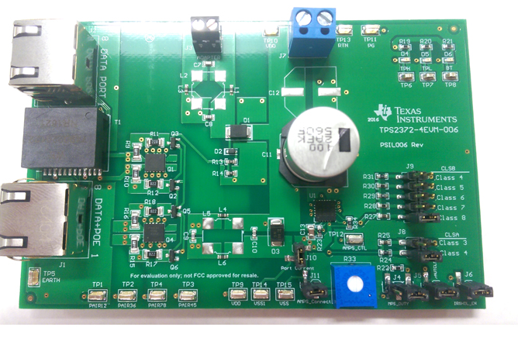
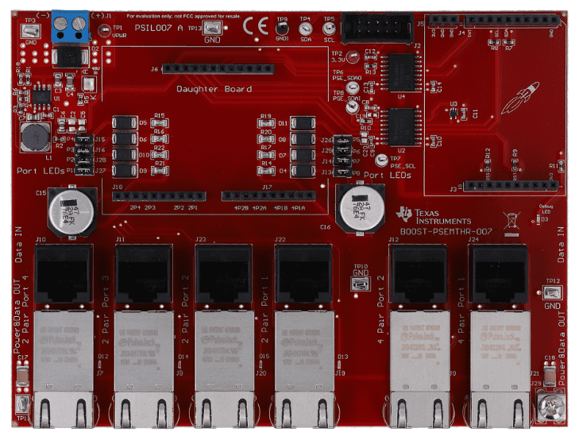
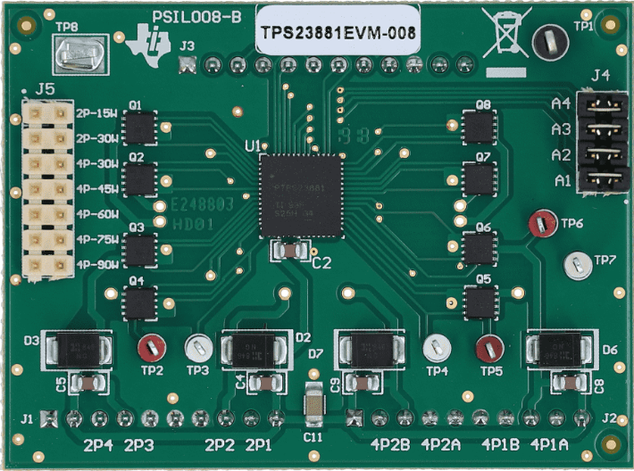
Connect VDD on TPS2372EVM to (+) on TPS23881EVM
Connect RTN on TPS2372EVM to (-) on TPS23881EVM
PD Input
Set to Class 4 and Class 4
PSE output

Slide 15
TI - Device Architecture
Autonomous mode:
No host controller needed in order to passthrough
Device 1
PD
TPS2372-3
PSE
TPS23881B1
Device 2
FET Bridge
44-57V
Vpwr
RJ45
RJ45
44-57V
44-57V
Vdd
LDO (TLV760)
3.3V
Buck
LM5116
5V
PD Load
5W

Slide 16
Static PoE Pass Through

Slide 17
Static PoE Pass-Through
Vdrop1
Efficiency hit 1
Vdrop2
Efficiency hit 2
PD
Input
54V
PSE
Output
PD
Input
54V
PSE
Output
PD Load
PD Load
System designer knows the number of daisies, and cable lengths, and input power:
Back-calculate how long the chain can be
  PD voltage at the last chain is above the UVLO threshold of the PD controller
Limit total solution within those system requirements

Slide 18
Dynamic PoE Pass Through

Slide 19
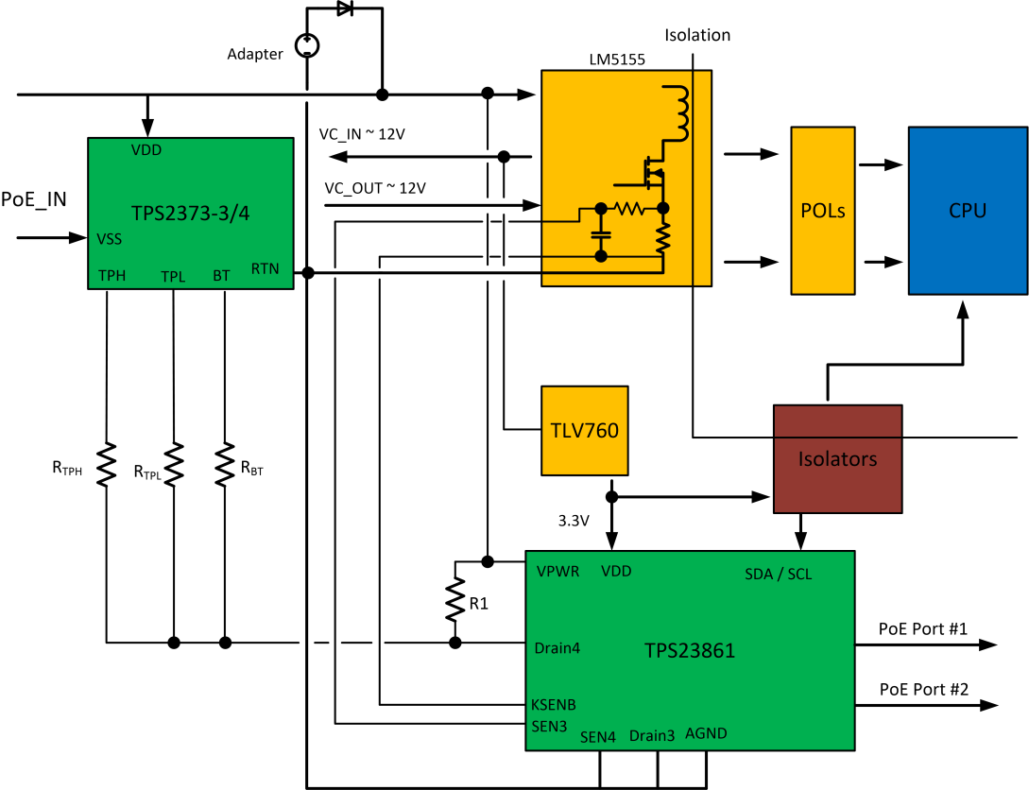
Architecture Proposal for 2 PSE ports
TPS2372-3
TPS23881B1

Slide 20
Determining what’s connected to the PD
PSE Type | Power Sourced from PSE (W) | Maximum Power at PD (W) | Class Signature A | Class Signature B | Number of Class Cycles | Resistor CLSA | Resistor CLSB | TPH | TPL | /BT
1-2 | 15.4W | 13.0W | 0 | 0 | 1 | 1210 | 1210 | HIGH | HIGH | HIGH
1-2 | 4W | 3.84W | 1 | 1 | 1 | 249 | 249 | HIGH | HIGH | HIGH
1-2 | 7W | 6.49W | 2 | 2 | 1 | 140 | 140 | HIGH | HIGH | HIGH
1-2 | 15.4W | 13.0W | 3 | 3 | 1 | 90.9 | 90.9 | HIGH | HIGH | HIGH
2 | 30W | 25.5W | 4 | 4 | 2 | 63.4 | 63.4 | HIGH | LOW | HIGH
3-4 | 15.4W | 13.0W | 0 | 0 | 1 | 1210 | 1210 | HIGH | HIGH | LOW
3-4 | 4W | 3.84W | 1 | 1 | 1 | 249 | 249 | HIGH | HIGH | LOW
3-4 | 7W | 6.49W | 2 | 2 | 1 | 140 | 140 | HIGH | HIGH | LOW
3-4 | 15.4W | 13.0W | 3 | 3 | 1 | 90.9 | 90.9 | HIGH | HIGH | LOW
3-4 | 30W | 25.5W | 4 | 4 | 2-3 | 63.4 | 63.4 | HIGH | LOW | LOW
3-4 | 45W | 40.0W | 4 | 0 | 4 | 63.4 | 1210 | LOW | HIGH | LOW
3-4 | 60W | 51.0W | 4 | 1 | 4 | 63.4 | 249 | LOW | HIGH | LOW
4 | 75W | 62.0W | 4 | 2 | 5 | 63.4 | 140 | LOW | LOW | LOW
4 | 90W | 71.3W | 4 | 3 | 5 | 63.4 | 90.9 | LOW | LOW | LOW
Adapter (APD HIGH) | NA | NA | NA | NA | NA | NA | NA | LOW | HIGH | HIGH
POE++ | 45 | 38.7 | 4 | 0 | 3 | 63.4 | 1210 | LOW | LOW | HIGH
POE++ | 65 | 52.7 | 4 | 1 | 3 | 63.4 | 249 | LOW | LOW | HIGH
POE++ | 90 | 70 | 4 | 2 | 3 | 63.4 | 140 | LOW | LOW | HIGH
POE++ | 123 | 90 | 4 | 3 | 3 | 63.4 | 90.9 | LOW | LOW | HIGH

Slide 21
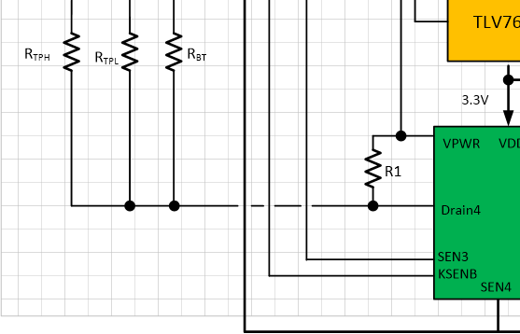
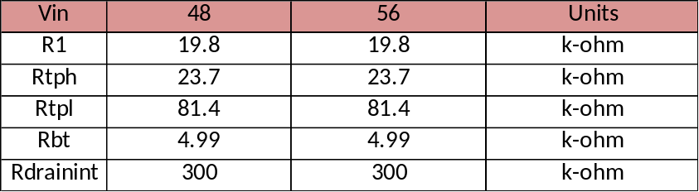
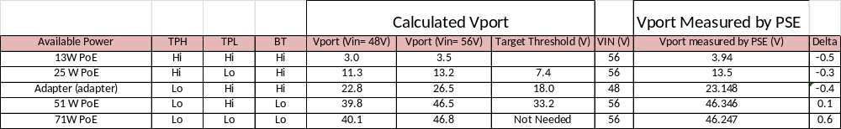
TPH TPL BT Measurements
Actual Resistance

Slide 22
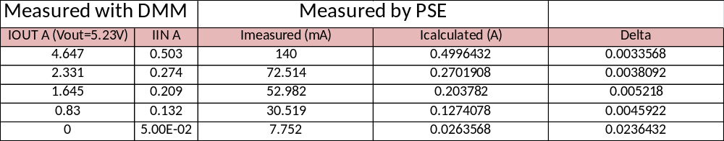
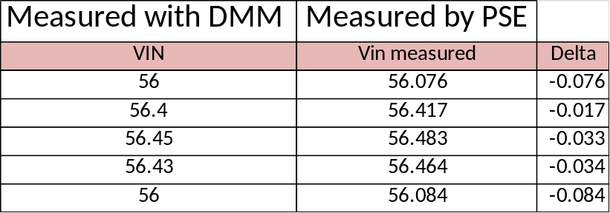
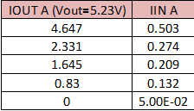
DCDC Input Voltage/Current Measurements
Current
Voltage

Slide 23
Passthrough Device Information

Slide 24
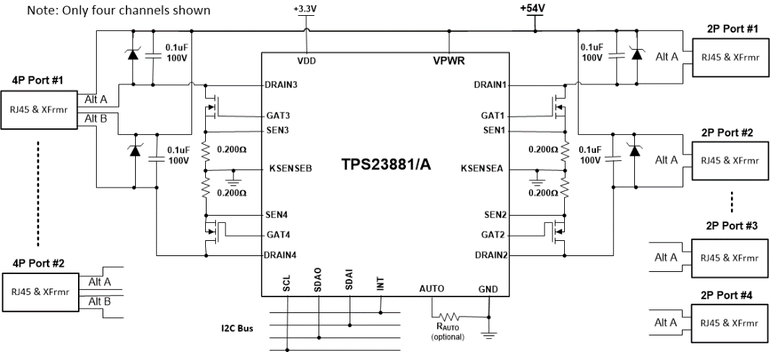

TPS23881B1
8-Channel 802.3bt Type-4 PSE w/ SRAM
Est. ETM Oct. ‘23
Features
Benefits
IEEE 802.3bt Ready
2-Pair (up to 30W) & 4-Pair (up to 125W) Configurable
I2C Programmable SRAM
Programmable power limiting accuracy ±2.5%
0.200 Ω Sense Resistor with Kelvin Sensing
Legacy PD Capacitance Measurement
Autonomous Mode
Autoclass Detection and Power Measurement
Single & dual signature PD compatibility
Fast port shutdown input w/ up to 8 priority settings
Short-Circuit Protection with Foldback
14-Bit Port Current and Voltage Monitoring
Ultra Low Alpha Packaging Available (TPS23881A)
IEEE 802.3bt interoperability
Flexible solution can deliver beyond .bt power levels
Firmware upgradability
Expand max power sourced to 95W w/o exceeding 100W
High current sensing accuracy and low power dissipation
Detect & power legacy PDs
Enables PSE systems without a host or I2C communication
Required for PoE lighting applications
Ability to detect and power dual signature PD loads.
Applications
Ethernet Switches and Routers
Lighting
Pass-through Systems
SOHO Routers
Ethernet Hubs
8 x 8 mm, 56-pin
QFN package

Slide 25
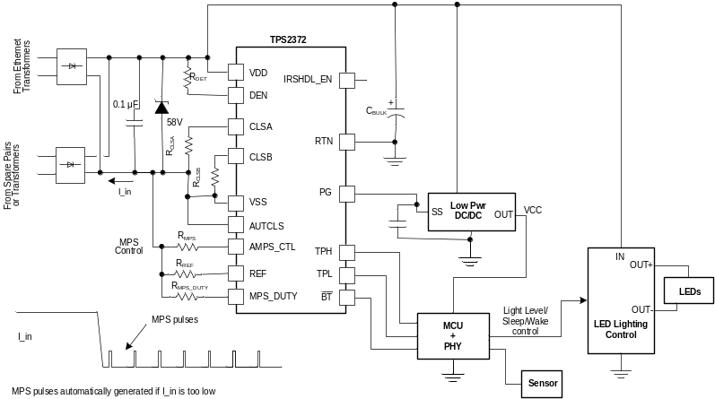
TPS2372-3/TPS2372-4
High Power .bt PoE PD Interface with MPS and Low Standby Power
Features
Benefits
IEEE 802.3bt, at and UPOE solution
Robust 100 V Hotswap MOSFET
  TPS2372-4 (typ.): 0.1-Ω, 2.2-A Current Limit
  TPS2372-3 (typ.): 0.3-Ω, 1.8-A Current Limit
Automatic Maintain Power Signature
Supports Autoclass
PG Output with PSE Inrush Completion delay
QFN20 Package (5x5 RGW)
Compliant PD I/F for 2- and 4-pair applications
High Power Robust Solution up to 90W and 60W
Allows Ultra-high “light load” efficiency solutions
  Ensures PSE will maintain power at any load
Allows optimum PSE power budgeting
No Interoperability issue with PSE during inrush
Applications
PoE Lighting
4-Pair Non-isolated PoE
Wireless Access Points
IP cameras
Notes:
25

